Slide 1
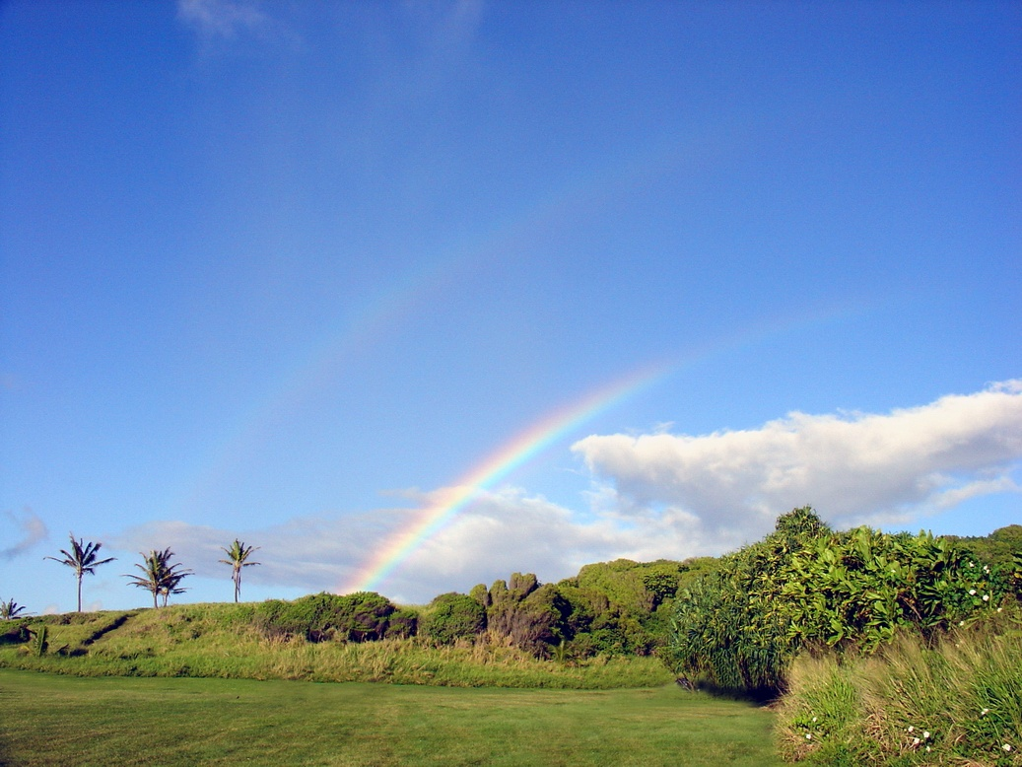
Weather & Climate
What’s the difference?

Slide 2
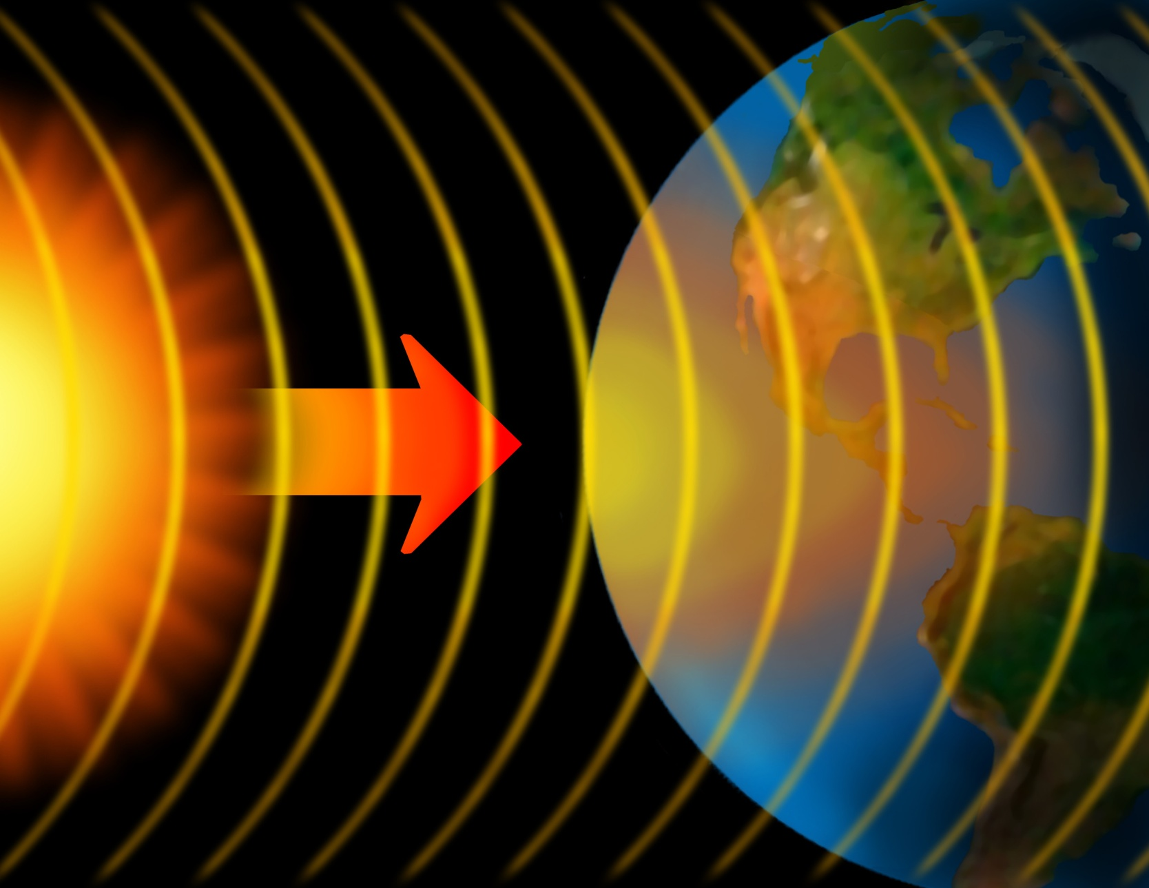
Weather begins with the sun
Notes:
Weather systems start because the sun’s energy heats up some parts of Earth more than others. Solar energy heats the equator more than the poles.

Slide 3

Weather describes whatever is happening outdoors in a given place at a given time.
How would you describe the weather in this picture?

Slide 4
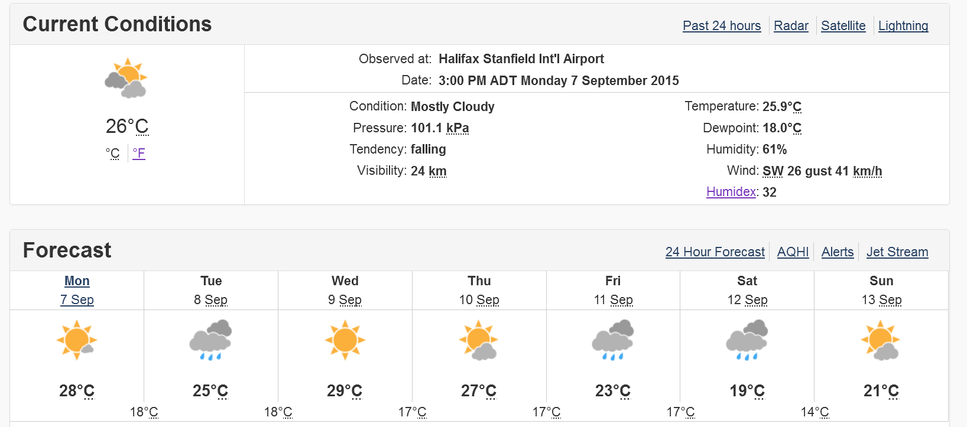
Weather changes every day!
What can you say about the weather forecast for this week?
Notes:
Weather includes daily changes in factors like precipitation, temperature, and wind conditions in a given location. What is the weather like right now?

Slide 5
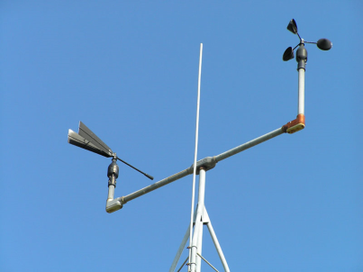
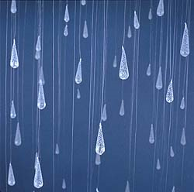
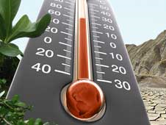
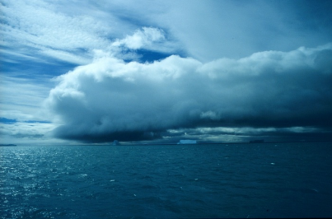
Some Weather Factors
Wind. Air in motion produced by the uneven heating of the earth’s surface by the sun.
Precipitation. Rain, snow, sleet and hail are all forms of precipitation.
Temperature. Temperature is how warm or cold it is outside.
Cloud Cover. There are many types of clouds that form in different conditions.
Notes:
In addition to the factors above, weather also includes factors such as UV radiation levels and air pressure. Air pressure affects a variety of weather conditions. Generally speaking, high air pressure means good weather and low pressure means potentially bad weather.

Slide 6
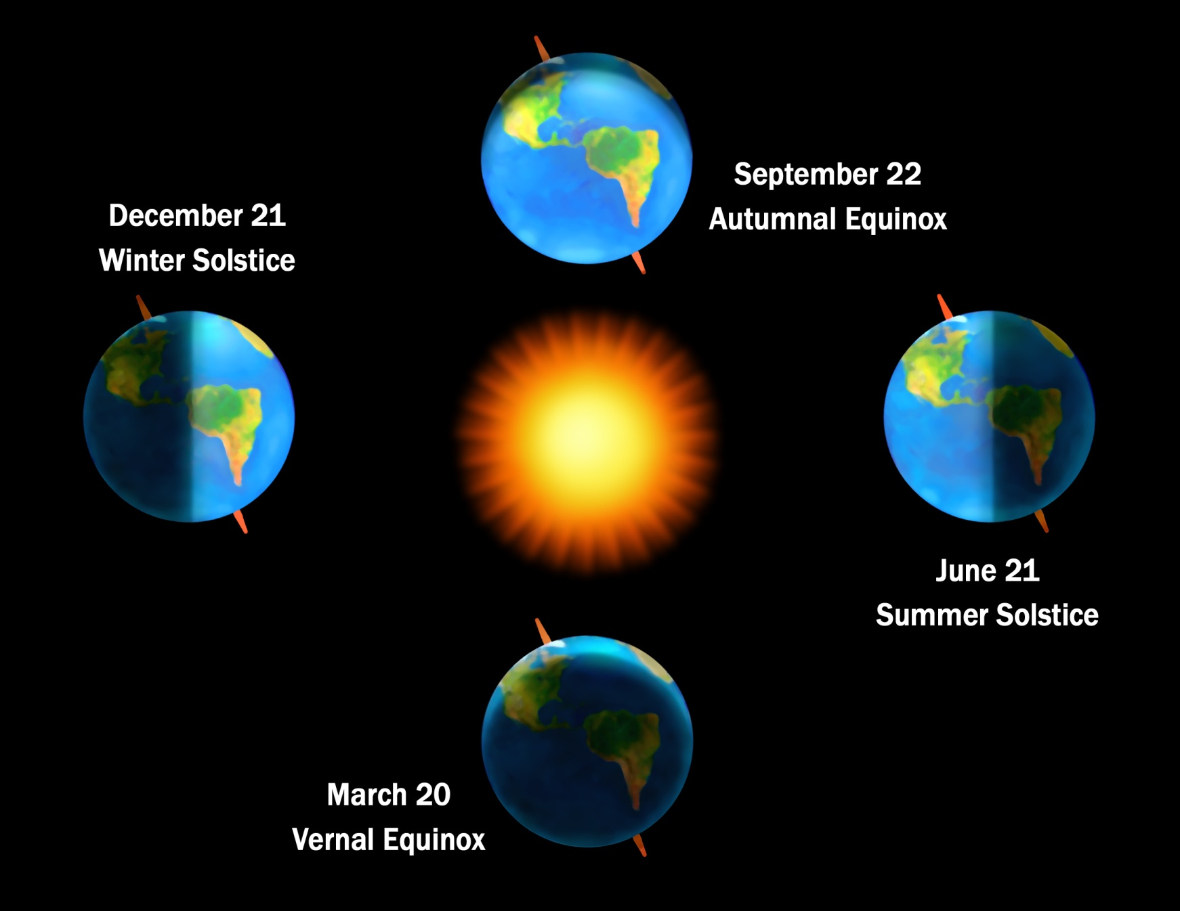
Seasons on Earth
Notes:
Seasons exist because the earth tilts on its axis towards the sun at different angles. As the sun shines on the earth, it shines more directly on the northern hemisphere in June, and more directly on the southern hemisphere in December. That's why the seasons are different in each hemisphere. In the spring and fall, the sun shines fairly straight on the equator, giving both hemispheres equal warming.
Weather changes as seasons change.

Slide 7
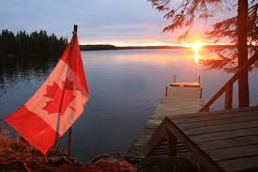
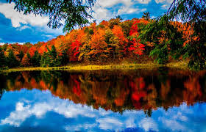
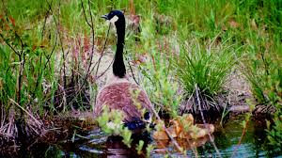
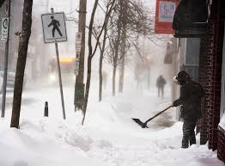
Summer
In Canada, we recognize four seasons:
Fall
Spring
Winter

Slide 8
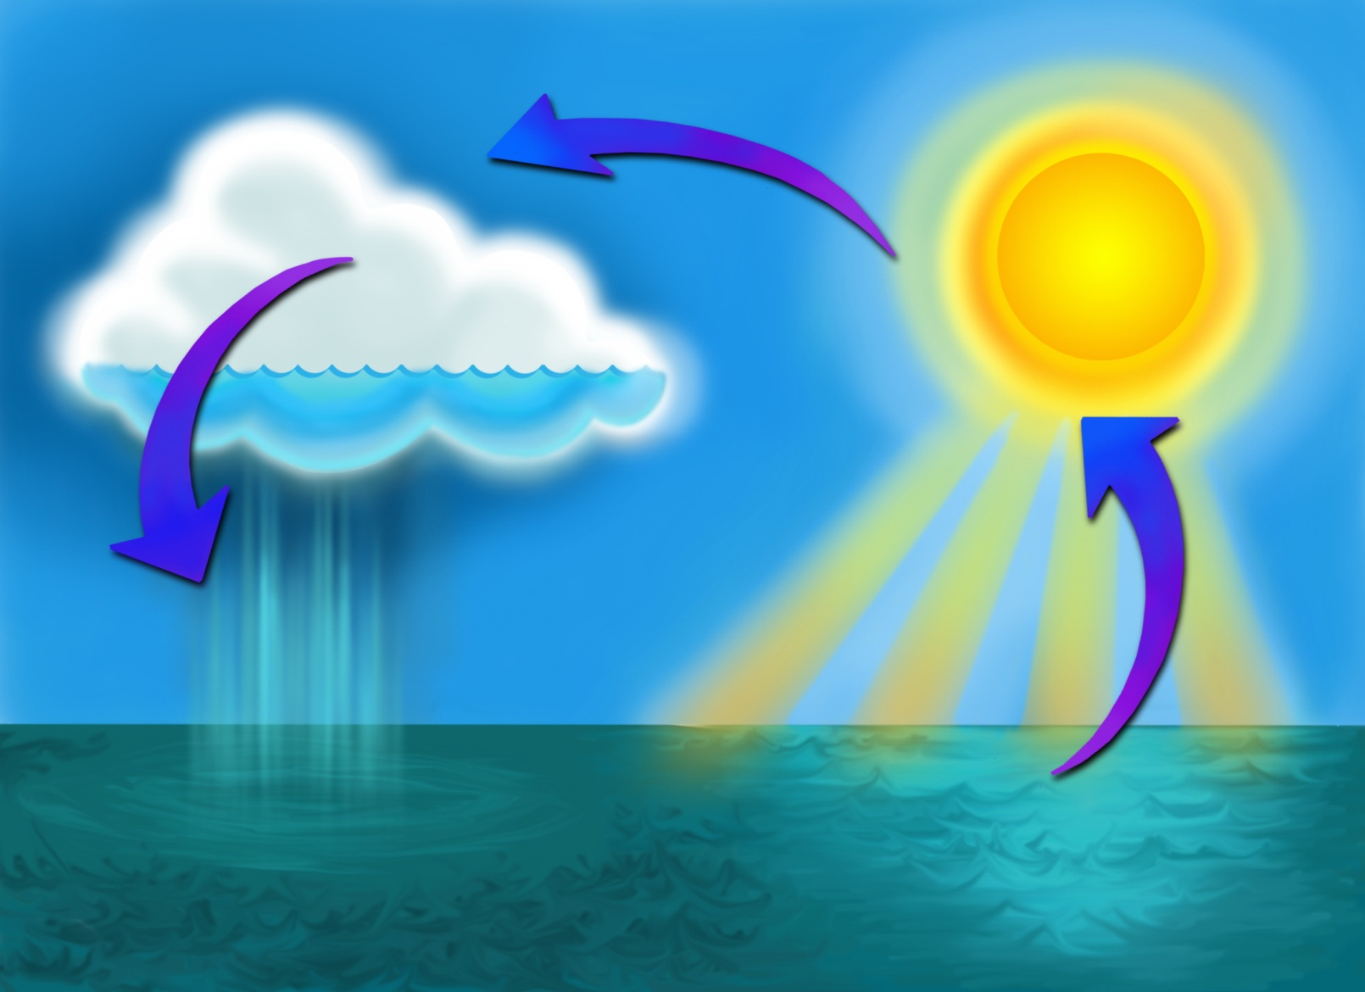
The water cycle affects both climate and weather
Notes:
The water cycle is powered from solar energy. The sun evaporates water from the entire Earth - 86% of the evaporation on Earth comes from the oceans. Evaporation cools the atmosphere and planets. The water cycle involves the evaporation, condensation and precipitation of water and all of these events shape the weather on a day to day basis. Evaporation and precipitation are ways in which water moves through the water cycle on any given day during a weather event.
During certain times of year and certain seasons, it might rain often causing plants, soils, rivers, and lakes to absorb more water. During other times of year, hot, dry weather can lead to water evaporation causing plants and soil to dry out and streams and rivers to have lower elevations, but over the course of a year or several years, a balance occurs in the water cycle so the amount of water entering the system is equal to the amount exiting. This balance in the water cycle helps stabilize the climate. Climate is affected by the natural fluctuation of the balance of water entering and exiting the system on a global scale.

Slide 9
Climate is weather measured over a long period of time
Weather = clothes for the day
Climate =
clothes in a closet
Notes:
The climate is the common, average weather conditions at a particular place over a long period of time (for example, more than 30 years). Think of climate as all the clothes in your closet – everything you need to wear to be comfortable all year. Think of weather as the clothes you wear for the day.

Slide 10
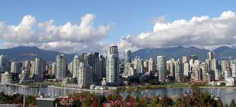

Climate describes the pattern of weather over a period of years in a given place.
Vancouver
Halifax
One of the warmest cities in Canada
Has a mild winter with little snow
A colder winter and more snow
Shorter summer

Slide 11
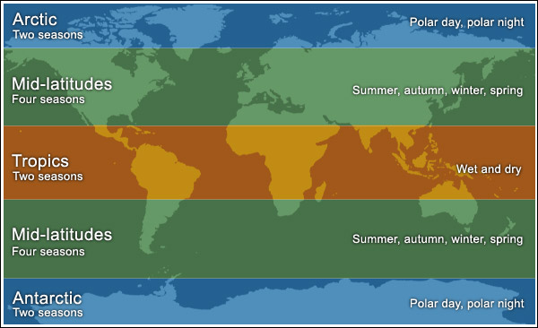
Climate Zones:

Slide 12
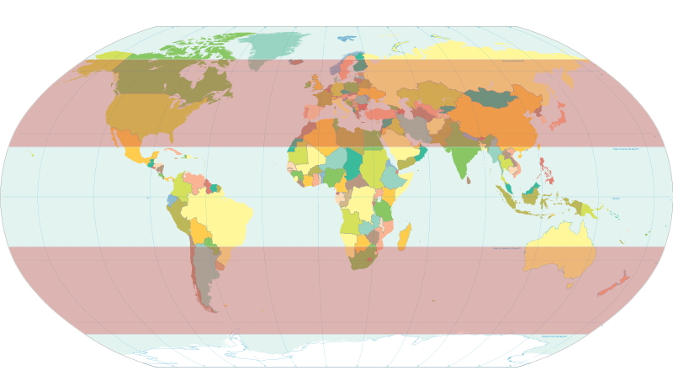
Climate Zones:
Mid-Latitude & Subtropical Climates
affected by two air masses: tropical air moving toward poles and
polar air masses moving toward equator
Notes:
This climate zone includes the dry-midlatitude, Mediterranean and moist continental climates.
For photos of places in the mid-latitude climates, click “Climate Zones” on the right side toolbar of webpage:
http://oceanservice.noaa.gov/education/pd/oceans_weather_climate/welcome.html

Slide 13
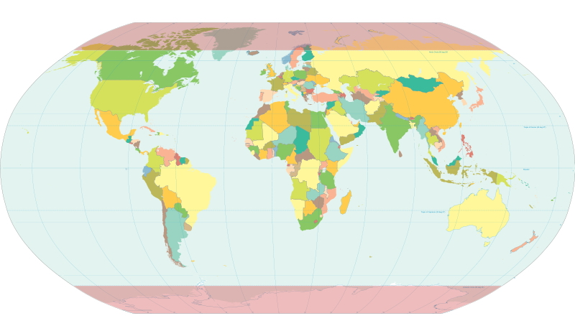
Climate Zones:
High-Latitude Climates
dominated by polar and arctic air masses
Notes:
This climate zone includes the boreal forest, tundra, and highland (alpine) or cold climates.
For photos of places in the high-latitude climates, click “Climate Zones” on the right side toolbar of webpage:
http://oceanservice.noaa.gov/education/pd/oceans_weather_climate/welcome.html

Slide 14
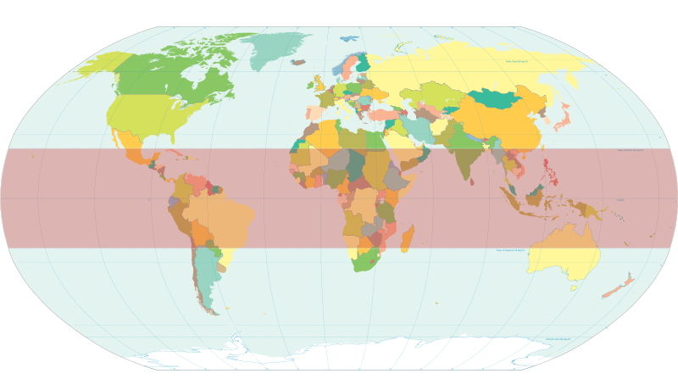
In which climate zone does Nova Scotia belong?
high latitude
mid latitude
Hint:
Consider the number of seasons.
low latitude
Notes:
Hawai`i is located in the tropics and the closeness to the equator would mean much higher temperatures but for the natural air conditioner that our trade winds provide. Hawai‘i has unique ecosystems and weather characteristics. Climates we encounter include humid tropical zones, arid and semi-arid zones, temperate zones, and at a (very) few locations, Alpine zones.

Slide 15
In which climate zone does Nova Scotia belong?
high latitude
mid latitude
Nova Scotia belongs in a mid latitude climate zone
low latitude
Notes:
Additional Info: The varied topography of Hawai`i creates several microclimates: windward lowlands, leeward lowlands, interior lowlands, rainy mountain leeward slopes, lower mountain leeward slopes, and high mountains. Each microclimate generally has its own wind patterns, temperature range, and precipitation patterns. The leeward sides of the islands are characterized by higher daytime and cooler nighttime temperatures. The area receives below-average amounts of precipitation compared to the windward side of the islands. The majority of the precipitation comes from winter storms carried by southwestern winds. The unique geography of each island creates wind patterns that are different between leeward and windward sides.

Slide 16
Weather & Climate
Which one would you describe as short-term and which one as long-term?

