Slide 1
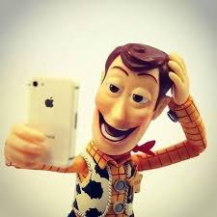
“Selfies”
Exactly where I want to be!

Slide 2
The 2013 word of the year, according to the Oxford Dictionary, was “selfie.”
This word was officially added to the dictionary and describes a photo someone takes of herself or himself to share with others through social media networks

Slide 3
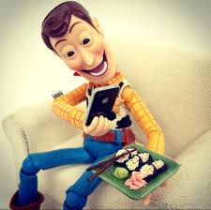
Often, a selfie is taken to share an experience in a specific location, and the background is just as important as the person in the photo.

Slide 4
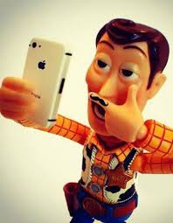
In this art assignment, selfies take a step back and become self-portraits, where you will focus on your facial features.
This likeness is then layered over a background of your choosing — a location you would find most exciting for taking a selfie.

Slide 5
These self-portraits may go to the moon, the bottom of the ocean, or anywhere else the imagination goes!

Slide 6
To infinity and beyond!

Slide 7
Let’s take a look!

Slide 8
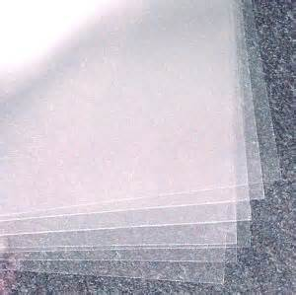
Materials
Oil pastels
Clear acetate sheets
Sharpie markers
Sandpaper
Chipboard
Macramé beads
Sandpaper

Slide 12
The finished product!

