Slide 1
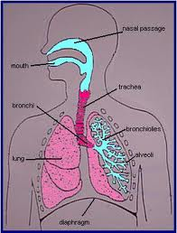
What is the function of the Respiratory System?

Slide 2
The Respiratory System brings oxygen into our body when we inhale and removes carbon dioxide from our body when we exhale.

Slide 3
How does the Respiratory System work?

Slide 4
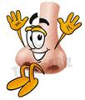
(1).
Air enters your body through your nose and mouth

Slide 5
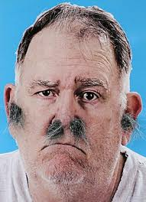
(2).
Cilia (tiny hairs) inside your nose, removes some of the dust and germs

Slide 6
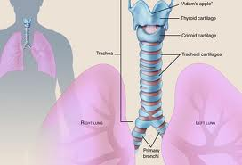
(3).
Air passes through the trachea (windpipe)

Slide 7
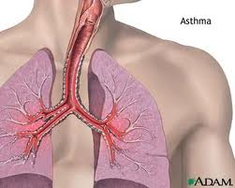
(4).
Air enters the lungs by passing through the left and right bronchus tubes

Slide 8
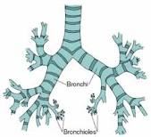
(5).
Air passes through smaller tubes called bronchioles

Slide 9
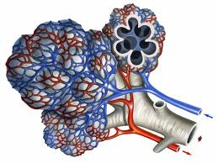
(6).
Air enters small air sacs called alveoli and an exchange
takes place

Slide 10
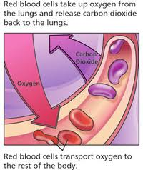
(7). (8).
Oxygen from the air goes into the blood
Carbon dioxide is removed from the blood
Carbon dioxide travels through the lungs, up the trachea, leaving the body when you breathe out
The blood carries the oxygen to all parts of the body

