Slide 1
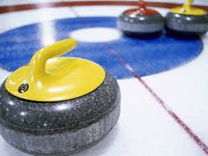
Moving with Force

Slide 2
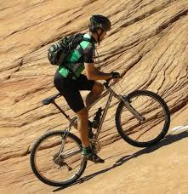
What forces are being used in this image?

Slide 3
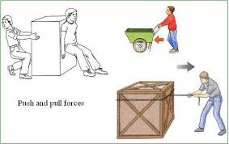
Moving with Force
Every day you use force.
Forces makes things move.
A force can be a push or pull.

Slide 4
What can forces do?
Forces cause things to move and speed up.
Forces make things slow down and stop.
Forces makes things change direction.
Summarize what forces can do.

Slide 5
Think about a sailboat.
A force such as the wind, can move objects in different ways. Wind can make objects speed up, slow down, change direction or stop.
When the wind blows strongly, the sailboat _______.
When the wind stops blowing, the sailboat _____ ____ or ______.
When the wind blows from a different direction, the sailboat __________ __________.
moves
slows down
stops
changes
direction

Slide 6
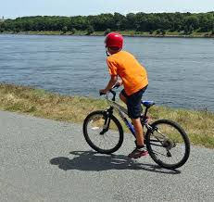
Are there different kinds of forces?
Body or Mechanical Forces – The _________ in your body provide the force to push or pull things. For example, your muscles provide the force to move a bike.
muscles

Slide 7
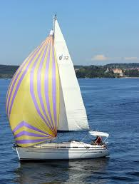
Are there different kinds of forces?
B. Wind Force – Wind is a _________. It can push the sail of a sailboat that then pushes the sailboat through the water.
force

Slide 8
Are there different kinds of forces?
C. The Force of Gravity – This force acts on your ______ all of the time. Gravity is the force that keeps you on the surface of the _______. It is the force that pulls everything towards the center of the earth. So if you jump, gravity pulls you back to the ground.
body
earth

Slide 9
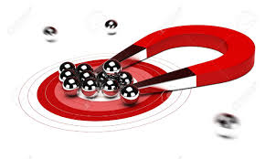
Are there different kinds of forces?
D. Magnetic Force – This force is created by a _________. A magnet makes a force that can push or pull against another magnet or some types of metal, without even touching it.
magnet

Slide 10
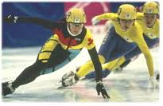
Are there different kinds of forces?
E. Friction– This is a force you get when two things _______. This force can slow things down or even make them stop moving.
rub

