Slide 1

Rings of Responsibility
Digital Citizenship

Slide 2



What do these circles remind you of?
Bull’s eye
Dart board
Target logo
Tree rings

Slide 3
Key Vocabulary
Responsibility: an obligation or duty you have to yourself or others

Slide 4
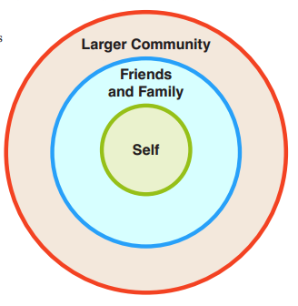
Rings of Responsibility

Slide 5
Key Vocabulary
Responsibility: an obligation or duty you have to yourself or others
Community: a group of people with a common background or shared interests

Slide 6
Rings of Responsibility
What responsibilities do you have to yourself?
What responsibilities do you have to your good friends and family??
What responsibilities do you have to the larger community?

Slide 7
Key Vocabulary
Responsibility: an obligation or duty you have to yourself or others
Community: clear and exact
Digital citizen: a member of a worldwide community linked by the Internet

Slide 8
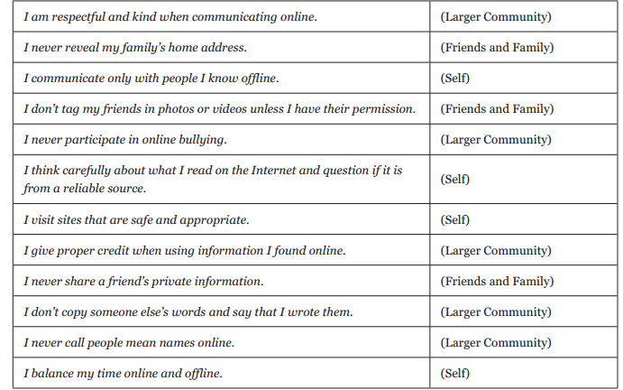

Slide 9
Let’s Review!
You are responsible for your own behaviour, whether it is in the offline world or in the digital (online) world.
You need to take your responsibilities – online and offline - seriously, because being responsible is crucial to being good members of the community and to becoming good digital citizens.

Slide 10
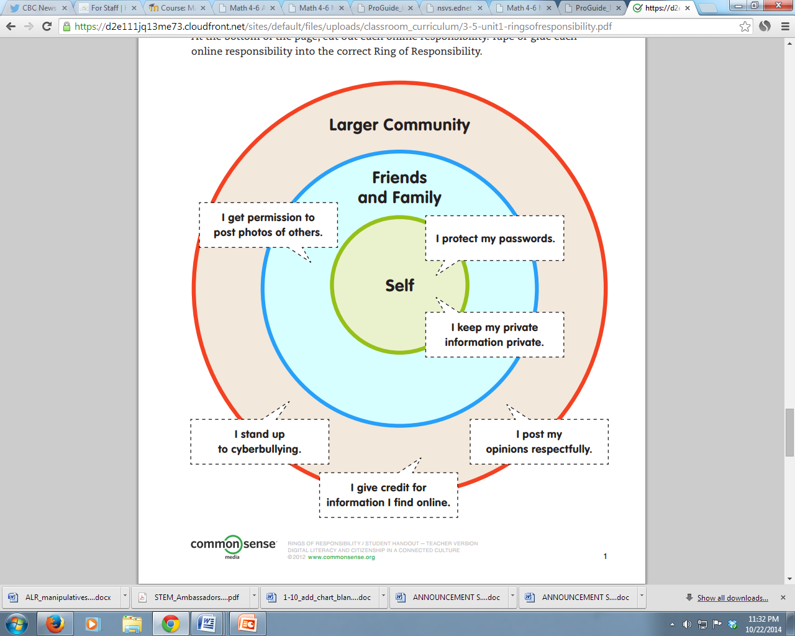

Slide 11

What are the three rings of responsibility?
What is one important responsibility you
have in the online world?
Is there a responsibility that you have to
others both online and offline?

Slide 12
What is the Internet?
https://www.commonsensemedia.org/videos/what-is-the-internet

Slide 13
Private and Personal Information
Digital Citizenship

Slide 14
What types of information do you think are okay to share publicly online, on a profile that others will see?
First name,
Interest and favourite activities
Opinions about a movie

Slide 15
What are some examples of websites where you must register in order to participate?
Social networking sites,
video-sharing sites,
youth discussion sites,
ask-an-expert sites,
game sites

Slide 16
Examples of websites where you must register in order to participate:
www.neopets.com
www.bookadventure.org
https://minecraft.net/
http://www.fun4thebrain.com/

Slide 17
What information is required and why do you think it is required?
First name
User name
Password
Password hint
Birth date
Gender
Province you live in
Parent’s permission

Slide 18
What information is optional, and why do you think it is optional?
Parent’s email
Birthday
Province
Country
Gender
Why do you think websites ask for this kind of information??

Slide 19
SAFE – Personal Information
UNSAFE – Private Information
Your favourite food
Your opinion (be respectful)
First name
Mother’s maiden name
Social security number
Your date of birth
Parent’s credit card info
Phone number

Slide 20
Why would someone want to steal someone else’s identity on the Internet?
To steal money
To do something bad or mean
To hide their real identity
Identity theft: when a thief steals someone’s private information in order to pretend to be that person

Slide 21
What kinds of information could an identity thief use to find out and steal your identity?
First and last name
Postal address
Phone numbers
Passwords
Credit card numbers
Social Security number
Mother’s maiden name

Slide 22
What kinds of personal information could you share about yourself without showing your identity?
Your age
Gender
How many brothers and sisters
Your favourite band
Your favourite food
What pets you have
The name of your pet
Your opinion about an issue

Slide 23
Let’s wrap it up !
What is identity theft?
How does personal information and private information differ?
What would be a good rule for kids about giving out private information?

Slide 24
https://www.commonsensemedia.org/videos/pause-think-online

Slide 25
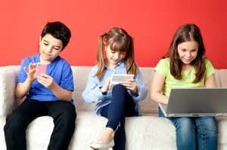
The Power of Words
Digital Citizenship

Slide 26
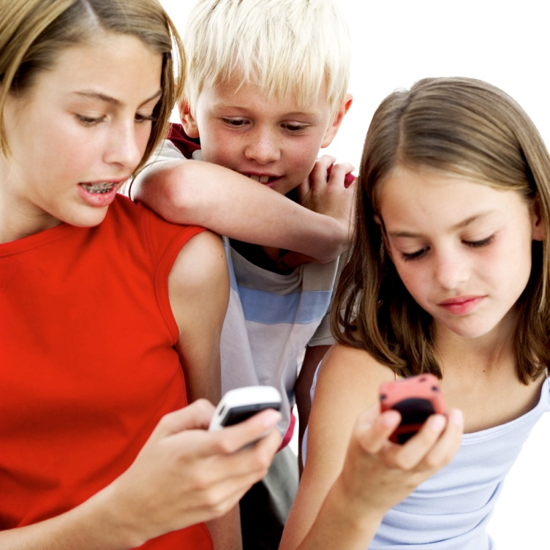
THE POWER OF WORDS
What should you do when someone uses mean or scary language on the Internet?

Slide 27
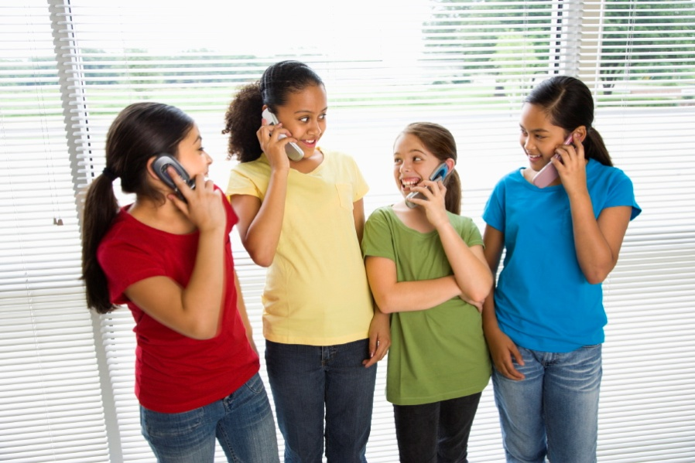
THE POWER OF WORDS
What are your favourite websites?
What are your favourite video games?
Who do you stay in touch with through cell phones and the Internet?

Slide 28
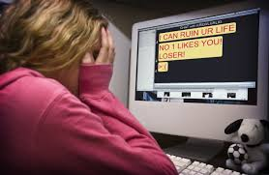
What’s the problem?
Have you seen messages sent to you or others online?
What are the reasons the person might have texted “You’re weird”?

Slide 29
https://www.commonsensemedia.org/videos/mindful-messaging

Slide 30
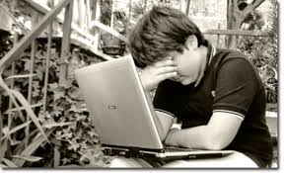
What is Cyberbullying?
Using technology tools such as the Internet and cell phones to deliberately upset someone else

Slide 31
Talk & Take Action
Cool down, take a breathe, count backwards and get calm
Find help or tell a trusted adult or friend. Adults can often influence the situation.
Ignore the bully as they often like attention, and may simply lose interest.
Remember to keep a copy of your communication with the bully.

Slide 32
https://www.commonsensemedia.org/videos/emmas-story-cyberbullied-by-a-best-friend

Slide 33
Let’s Review
Why is it a bad idea to send mean or scary messages online?
Why are there more misunderstandings with online messages than with face-to-face discussions?
What can kids do when they get cyberbullying messages?

Slide 34

The Key to Keywords
Which keywords will give you the best search results?

Slide 35
Key Vocabulary
Keywords: the most important words related to a subject, which you type into a search engine to find the information you want
Precise: clear and exact

Slide 36

How do search engines like Google work?
They crawl the Internet, gathering information about millions of websites. At the click of a button, a search engine sorts through what it ‘knows’ and lists the sites it ‘thinks’ you want. You tell the search engine what you want by using keywords.

Slide 37
Key Vocabulary
Keywords: the most important words related to a subject, which you type into a search engine to find the information you want
Precise: clear and exact
Results page: the screen showing what a search site found in response to your keyword search

Slide 38
Results Page: Some Tips
Important to choose accurate and precise words
Adding more keywords can narrow a search
A single word may ‘fetch’ a million sites
Adding more words ‘fetched’ fewer sites
Put words that belong together in quotation marks

Slide 39
ASSIGNMENT
Use Google Kids as your search engine
You and a partner will be assigned one question to answer
Record your assigned question on sheet:
  What foods are toxic to dogs?
  What breeds of dogs are the smartest?
  What jobs do dogs do for people
  What are some of the smallest and largest dog breeds? (name two of each)?

Slide 40
Your Task:
SEARCH for the answer to your question using a single keyword
RECORD the total number of sites found
INVESTIGATE the top three sites to find answers to questions
REPEAT the previous three steps, using two keywords, three keywords, and so on
WRITE the answers to questions on sheet

Slide 41
https://www.commonsensemedia.org/videos/solomons-story-online-searching

Slide 42
Synonym: two or more words with the same meaning or nearly the same meaning
Alternative: a different way to say or do something
Find a synonym for the word ‘strong’

Slide 43
DOGGY DATA
YOUR TASK: To see how quickly you can hunt down specific information about dogs
One group member will record information
Record keywords used to search
Record at least two sites where you found answers
CHALLENGE: Find the answers to the 3 questions in as few searches as possible
Choose keywords carefully – group terms that go together using “quotation marks”

Slide 44
Let’s Review!
What are keywords?
Is it better to use more than one keyword in a search? Why or why not?
How does using synonyms or alternative phrases help when submitting a search?

