Slide 1
Clouds

Slide 2
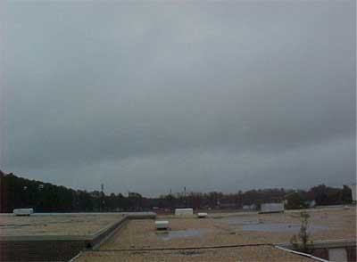
Stratus Clouds
They are grayish clouds that are low in the sky. They almost look like a blanket covering thy sky – like fog.
Associated weather: overcast, sometimes drizzling, fog

Slide 3
Cumulus Clouds
Cumulus clouds are puffy clouds found in the middle of the sky that look like puffs of cotton.
Associated weather: clearing weather, fair or pleasant
Interesting Fact:
These clouds grow upward and they can develop into giant cumulonimbus clouds, which are thunderstorm clouds.

Slide 4
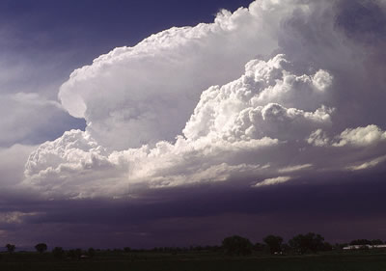
Cumulonimbus
Cumulonimbus clouds are thunderstorm clouds. They grow dark, large, and tall.
Associated weather: heavy rain, snow, hail, thunder, lightning

Slide 5
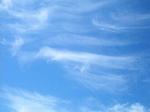
Cirrus Clouds
Cirrus clouds are found very high up in the sky.
They are thin and wispy clouds.
Associated weather: fair or pleasant, first sign of an approaching storm
Interesting fact:
These clouds indicate there will be a change in the weather in the next 24 hours.

Slide 6
Your turn!
Name each cloud.
Record the type of weather associated with each cloud.

Slide 7
#1

Slide 8
#2

Slide 9
#3

Slide 10
#4

Slide 11
#5

Slide 12
#6

Slide 13
#7

Slide 14
#8

