Slide 1
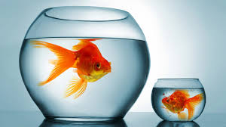
Capacity
Personal Referents

Slide 2
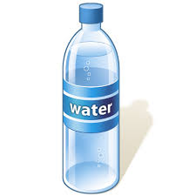
Water bottle
Millilitres or litres?
Exactly one litre

Slide 3
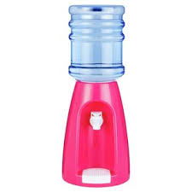
Water cooler
litres
A standard-sized mug holds ~ 19 litres

Slide 4
Coffee mug
Millilitres
A standard-sized mug holds ~ 350 millilitres

Slide 5
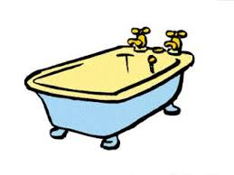
Bathtub
litres
A standard-sized tub holds ~ 200 litres

Slide 6
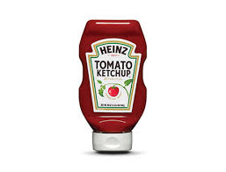
Bottle of Ketchup
Millilitres
A standard-sized bottle holds ~ 575 millilitres

Slide 7
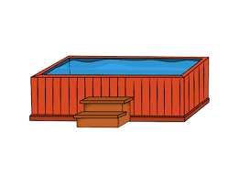
Hot tub
LItres
A standard-sized hot tub holds ~ 1500 litres

Slide 8
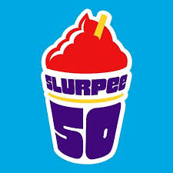
slushee
Millilitres
A regular-sized slushee holds 473 millilitres

Slide 9
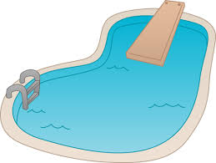
Swimming Pool
LItres
A standard-sized pool holds ~ 50 000 litres

Slide 10
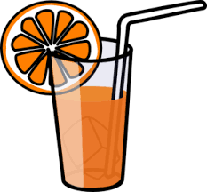
Juice glass
Millilitres
A standard-sized glass holds ~ 230 millilitres

Slide 11
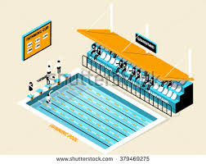
Olympic-sized Pool
LItres
An Olympic pool holds 2 500 000 litres

Slide 12
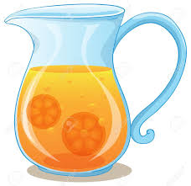
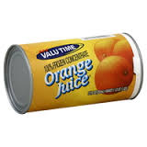
Task 1:
A jug holds 1.5 l
Is the jug large enough to make a jug of orange juice, if you must mix 355 mL can of orange juice concentrate with three full cans of water?
Explain your thinking.

Slide 13
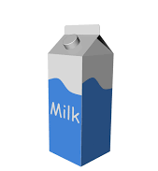
Task 2:
This milk carton holds 1 L.
How could you use a 1 L milk carton to estimate 750 mL of water?
Explain your thinking.

Slide 14
Nice work!

